Slide 1
Epithelial tissue
Dr Hemed El-busaidy

Slide 2
Objectives
Universal characteristics of epithelial tissue
Functions
Classification
Surface specialization
Intercellular junctions/Junctional complexes
Clinical significance
practical

Slide 3
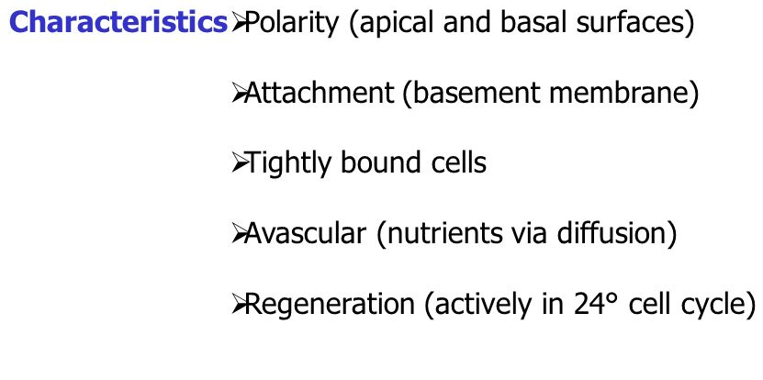

Slide 4
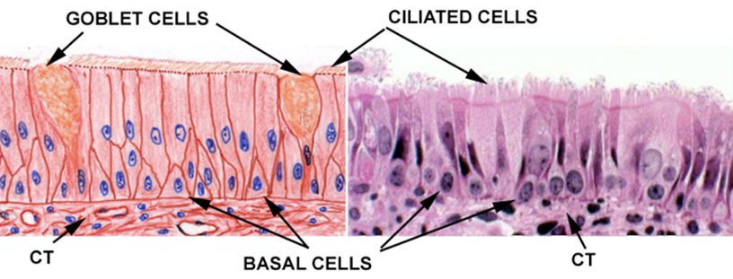
Example of an epithelium
Polarity & surface specialization
Basement membrane
Tightly packed cells

Slide 5
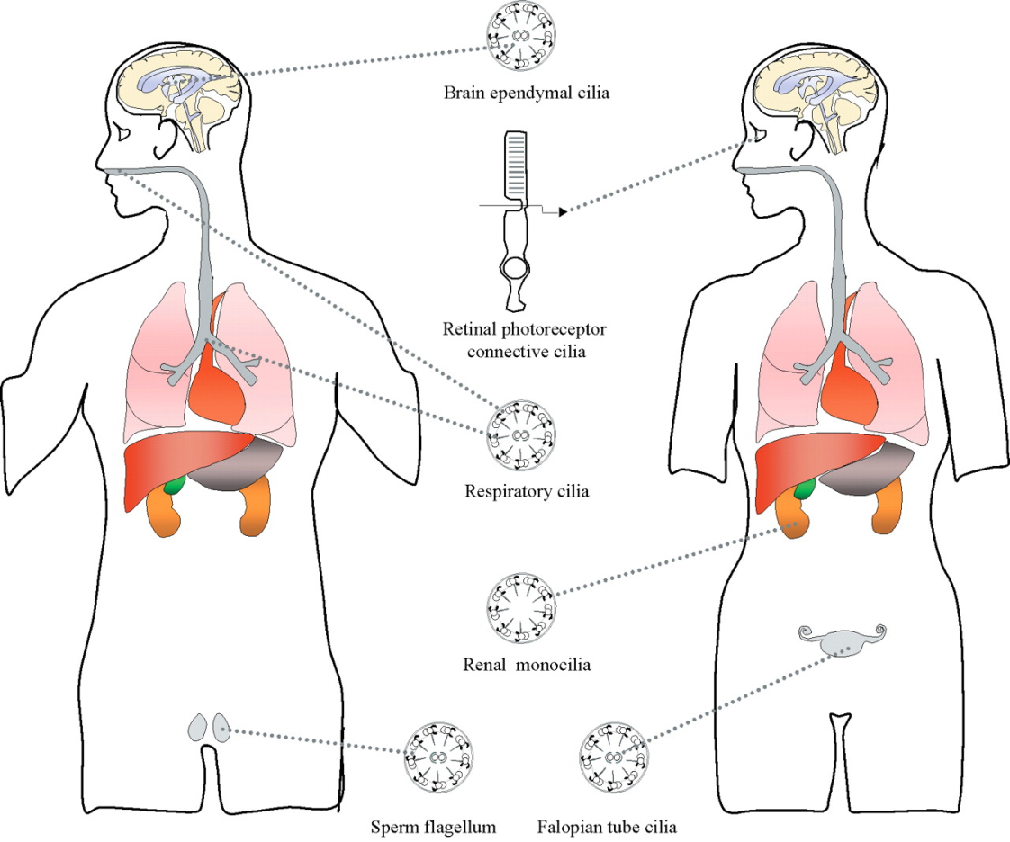
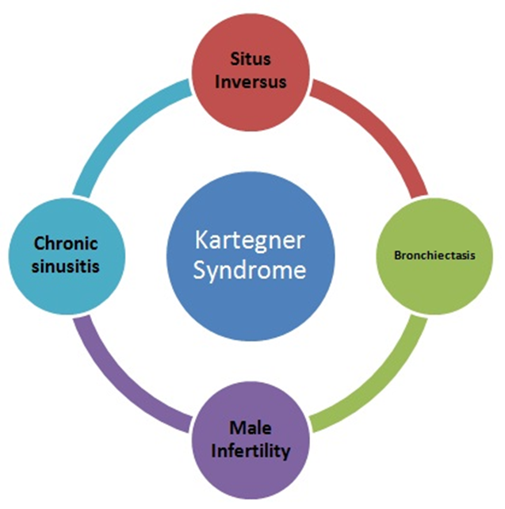
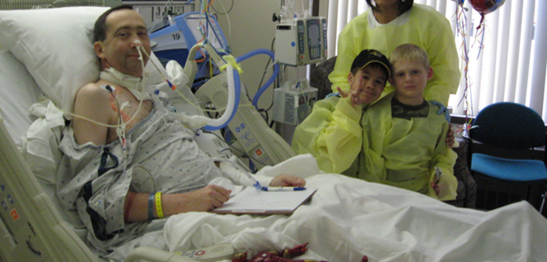
Distribution & disorders of cilia
Kartegener’s syndrome
Smokers lung/ smokers cough
Epithelial metaplasia (lung cancer)
hydrocephalus

Slide 6
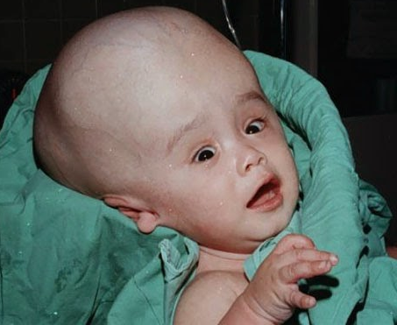
hydrocephalus

Slide 7
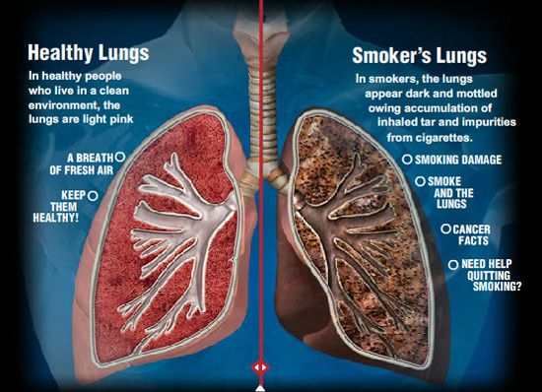
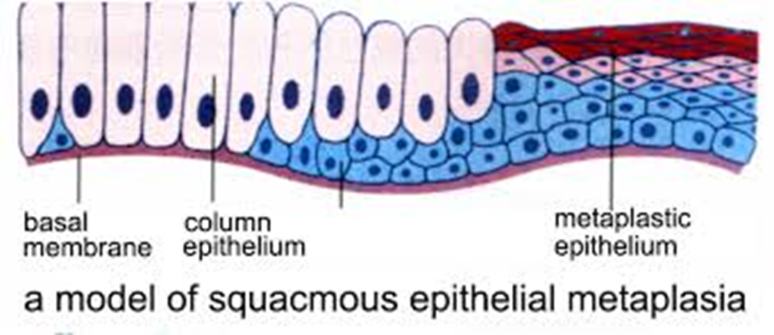
Smoker vs non smokers lung

Slide 8
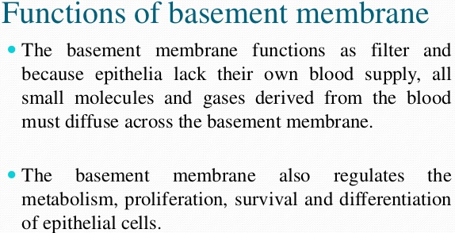
The basement membrane

Slide 9
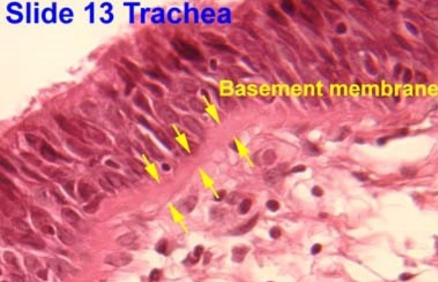
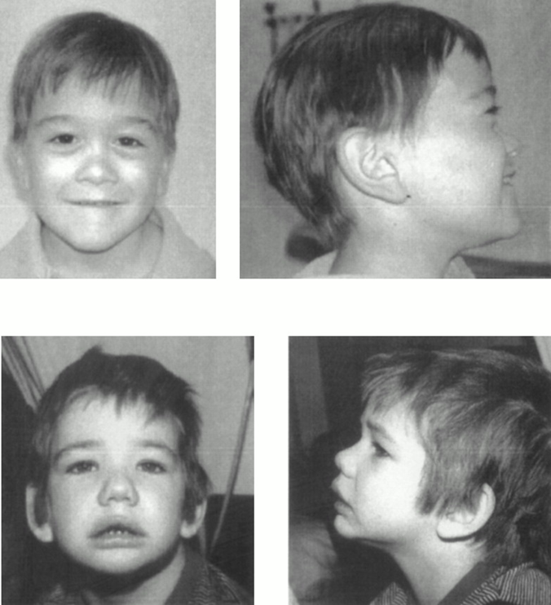
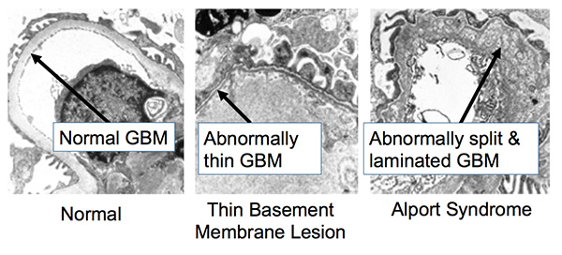

Slide 10
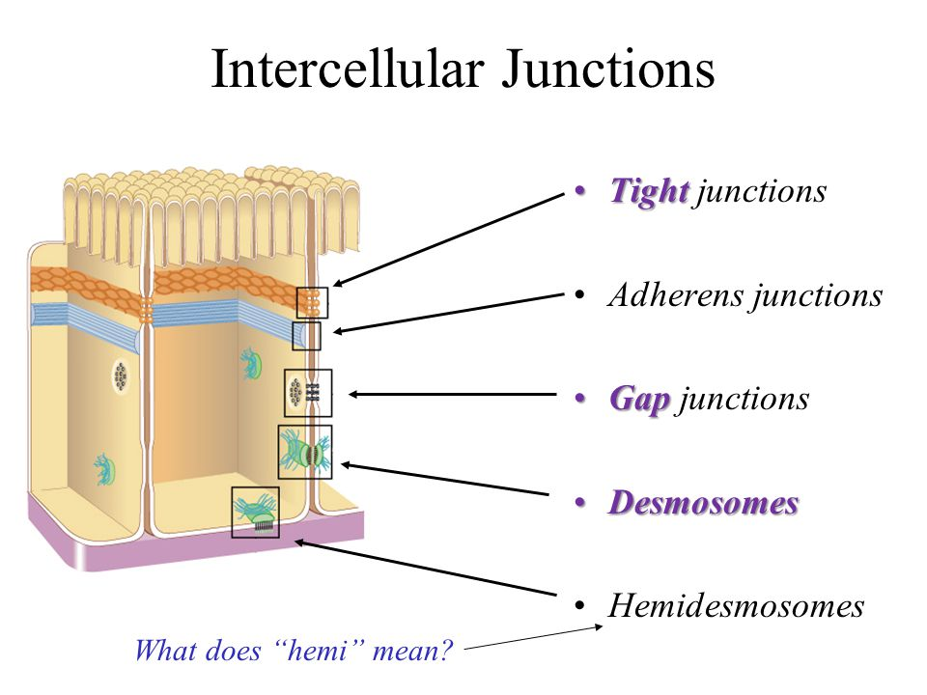
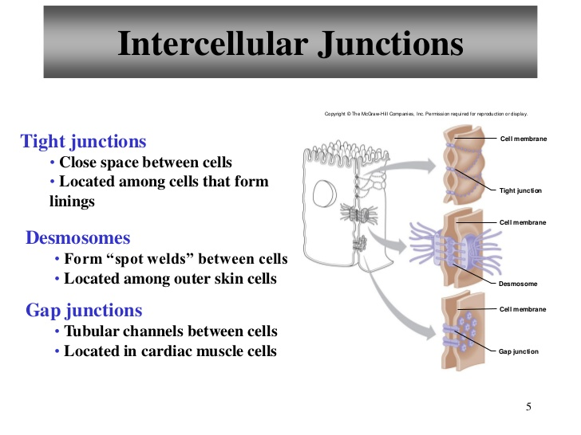
Intercellular junctions/junctional complexes

Slide 11
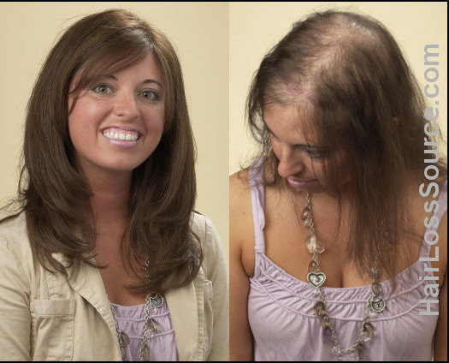
Avascularity & regeneration
Avascularity: get nutrition by diffusion from underlying connective tissue
Regeneration: eg GIT epithelium, endosteum of the bone marrow
Alopecia

Slide 12
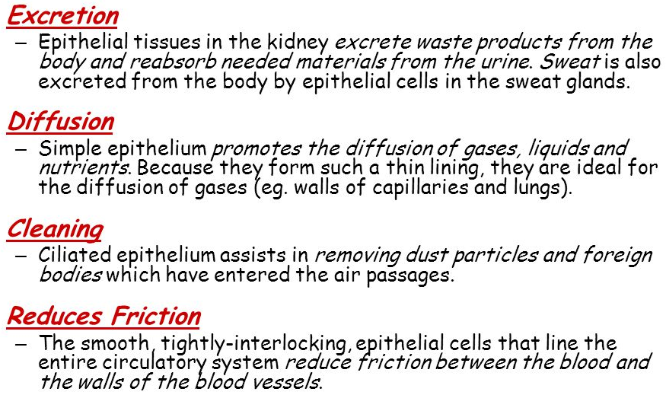
Functions of epithelial tissue

Slide 13
Epithelial Tissue
Epithelial Tissue Locations:
Covers the body
Lines the cavities, tubes, ducts and blood vessels inside the body
Covers the organs inside body cavities
Epithelial Tissue Functions:
Protection from physical & chemical injury,
Protection against microbial invasion,
Contains receptors which respond to stimuli,
Filters, secretes & reabsorbs materials and
Secretes serous fluids to lubricate structures.

Slide 14
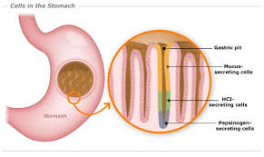
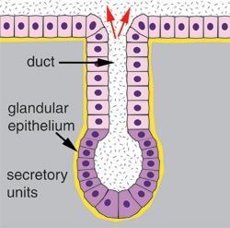
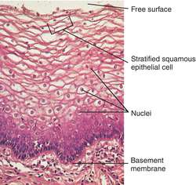
Classification of epithelial tissue
Functional classification:
Lining epithelium
Glandular epithelium
Based on number of cell layers:
Simple epithelium
Stratified epithelium
Based on shape of cells:
Squamous
Cuboidal
Columnar
pseudostratified

Slide 15
Key concepts
Squamous epithelium is lining eg blood vessel
Cuboidal epi is secretory eg kidney
Columnar epi is absorptive eg STOMACH

Slide 16
Epithelial Types based on shape of cells
Simple squamous – inside blood vessels
Simple cuboidal – lines ducts, ex. Kidney tubules, mucous glands
Simple columnar – lining of small intestine
Pseudostratified Columnar – trachea, bronchi
Transitional epithelium- urinary bladder

Slide 17
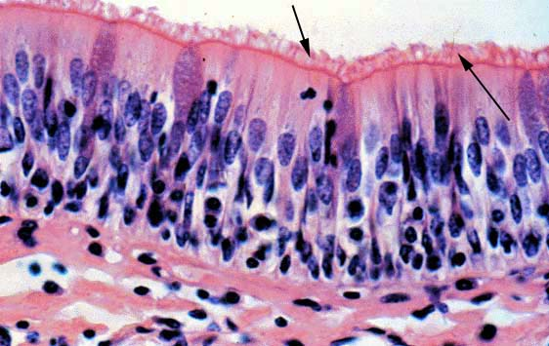
Pseudostratified Columnar

Slide 18
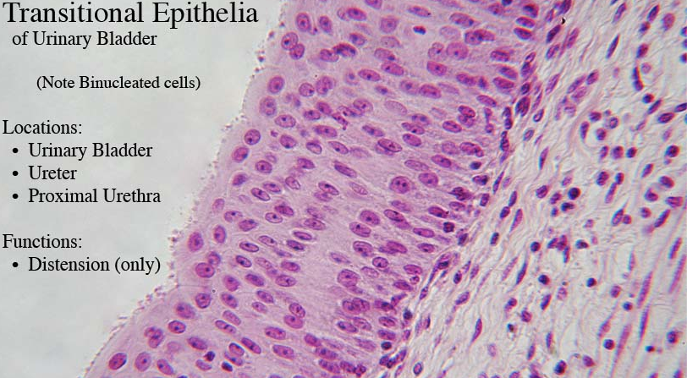
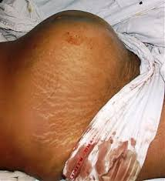
Distended urinary bladder

Slide 19
Surface specialization
Cilia
Stereocilia
Villi
Microvilli

Slide 20
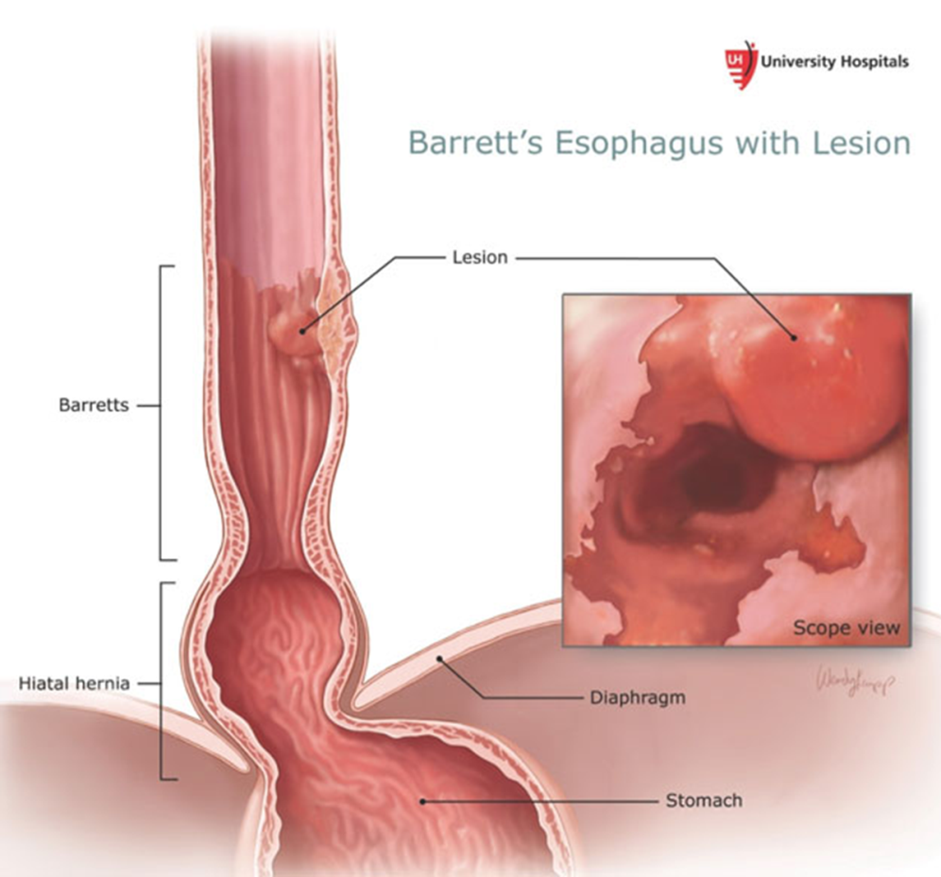
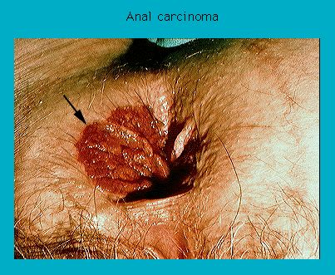
Clinical significance of epithelial tissue
Epithelial metaplasia

Slide 21
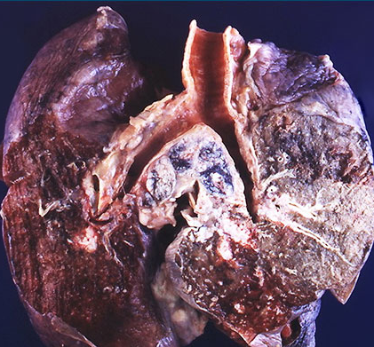
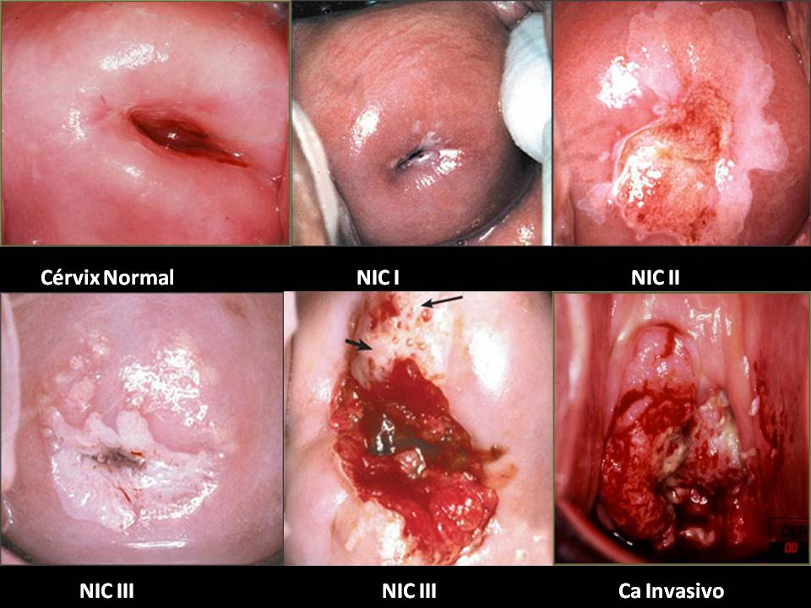
Cervical cancer
Lung cancer

Slide 22
Practical
blood vessels
Kidney tubules,
small intestine
trachea,
urinary bladder

